Slide 1


Slide 2
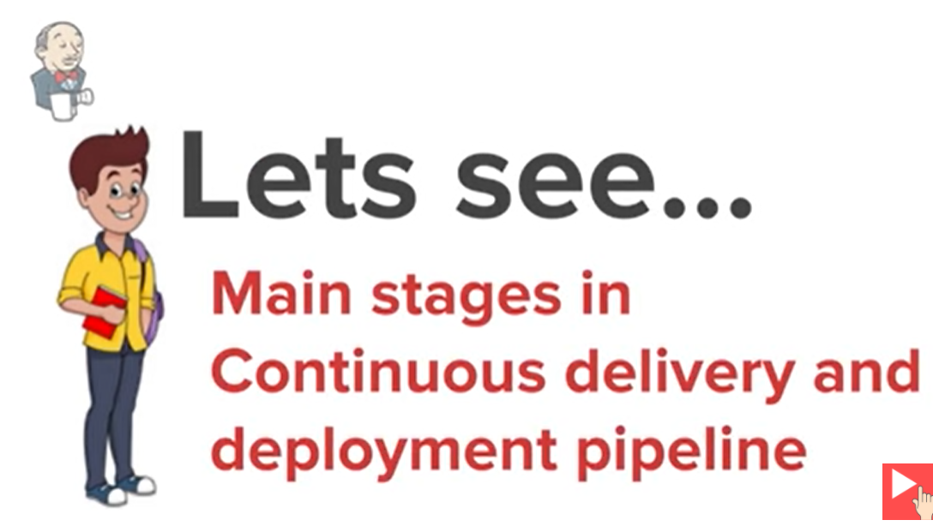

Slide 3
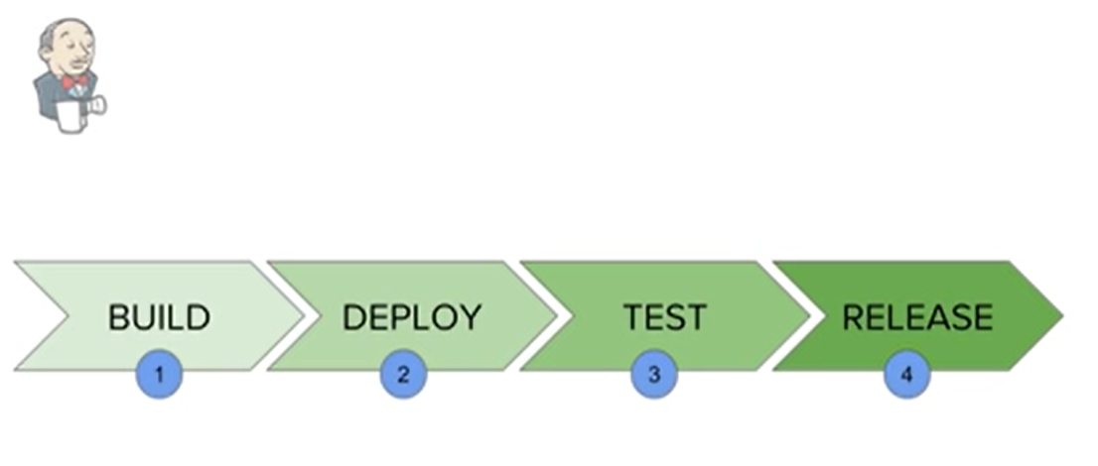

Slide 4
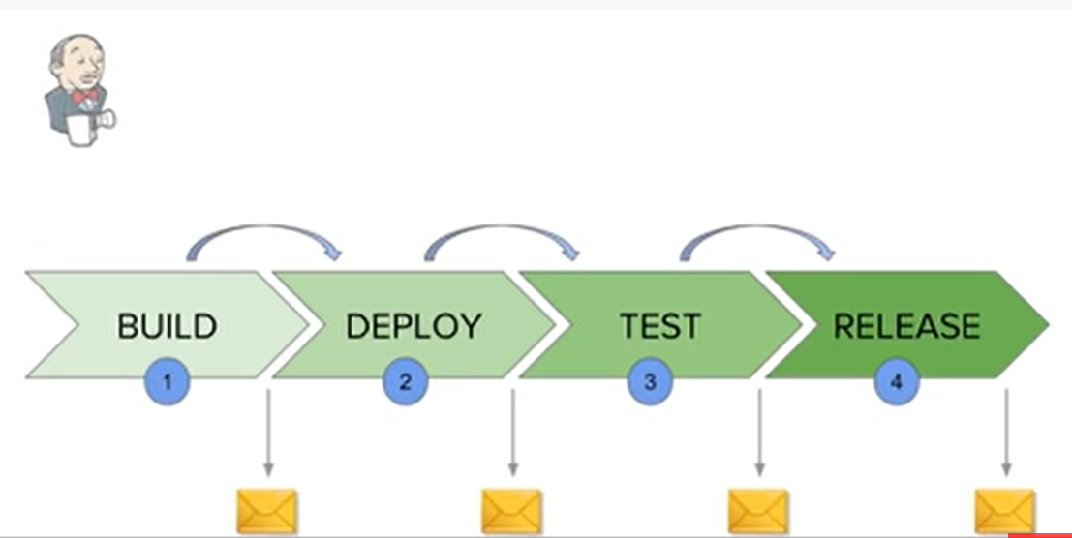

Slide 5
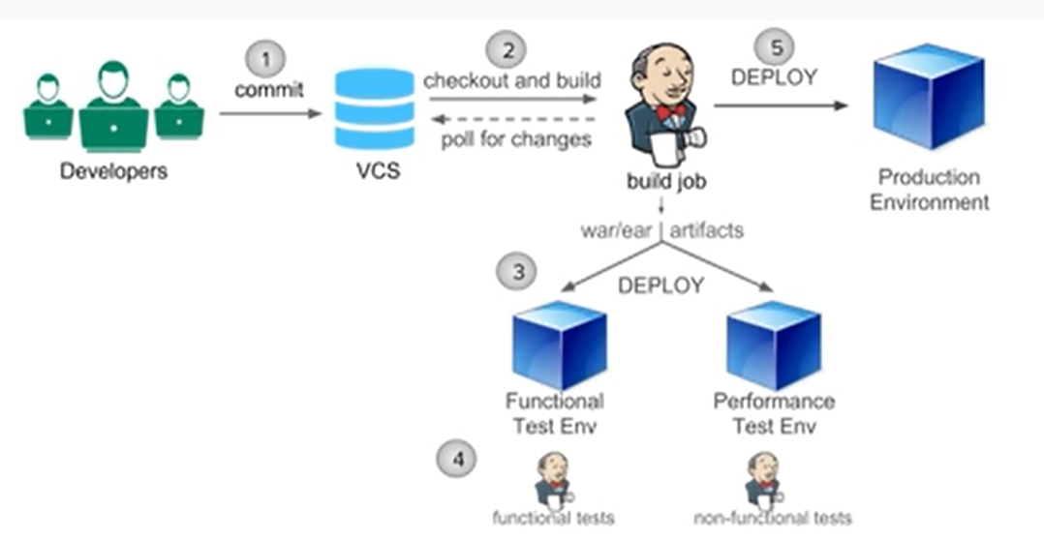

Slide 6
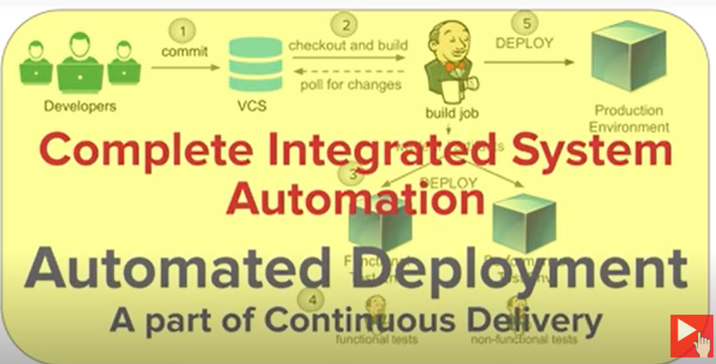

Slide 7
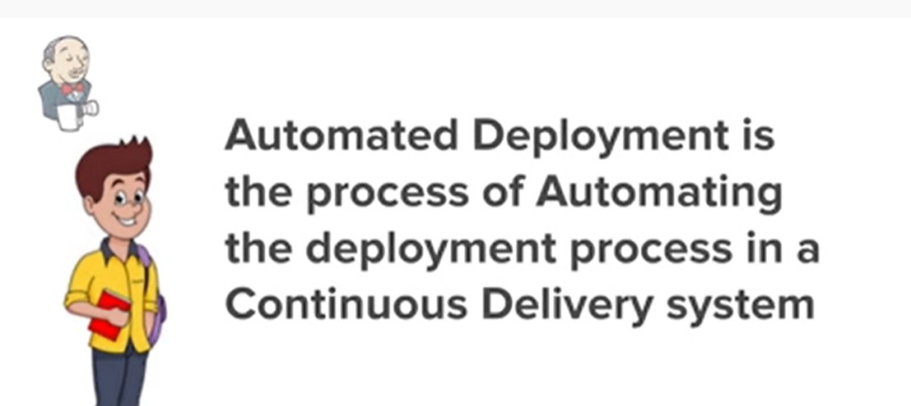

Slide 8
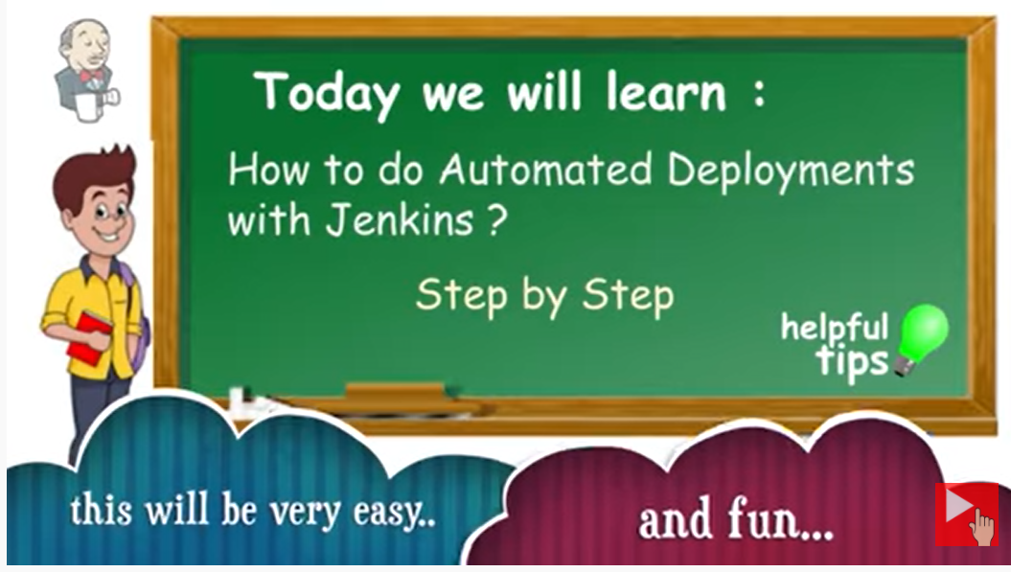

Slide 9


Slide 10
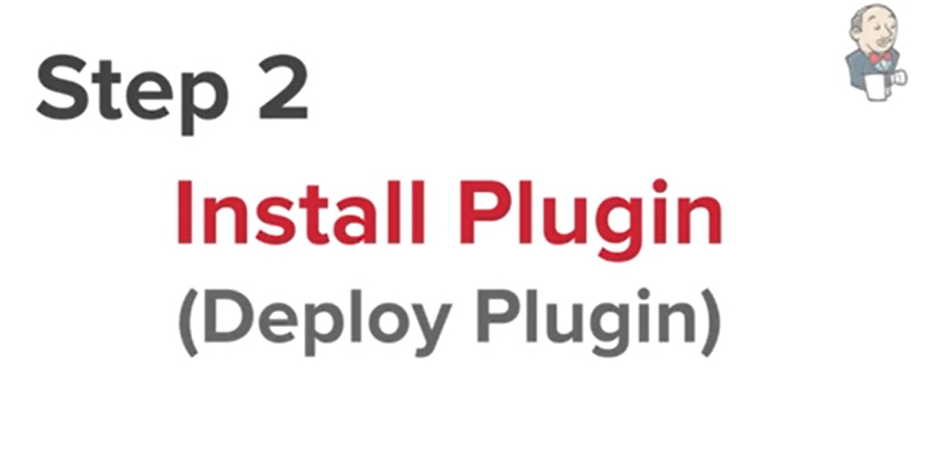

Slide 11
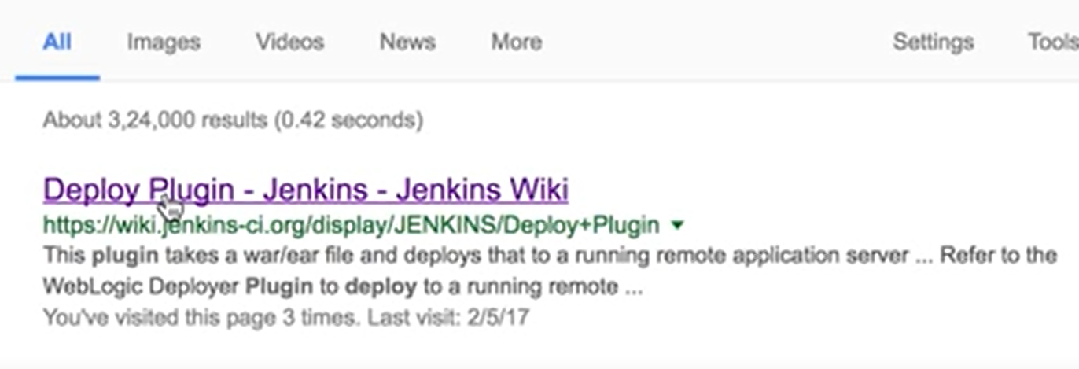

Slide 12


Slide 13
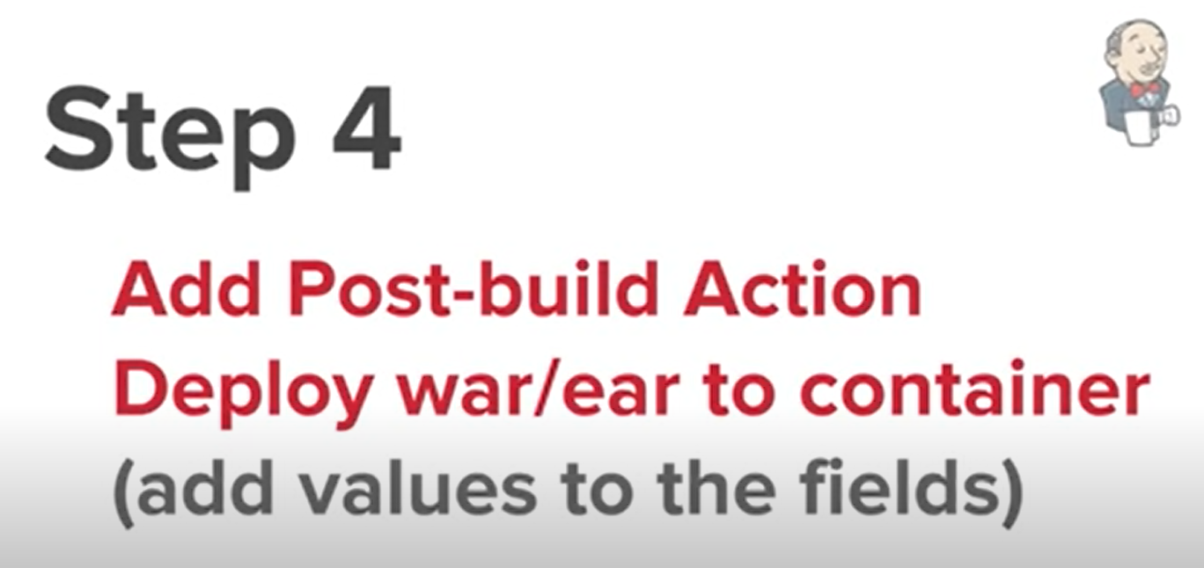

Slide 14
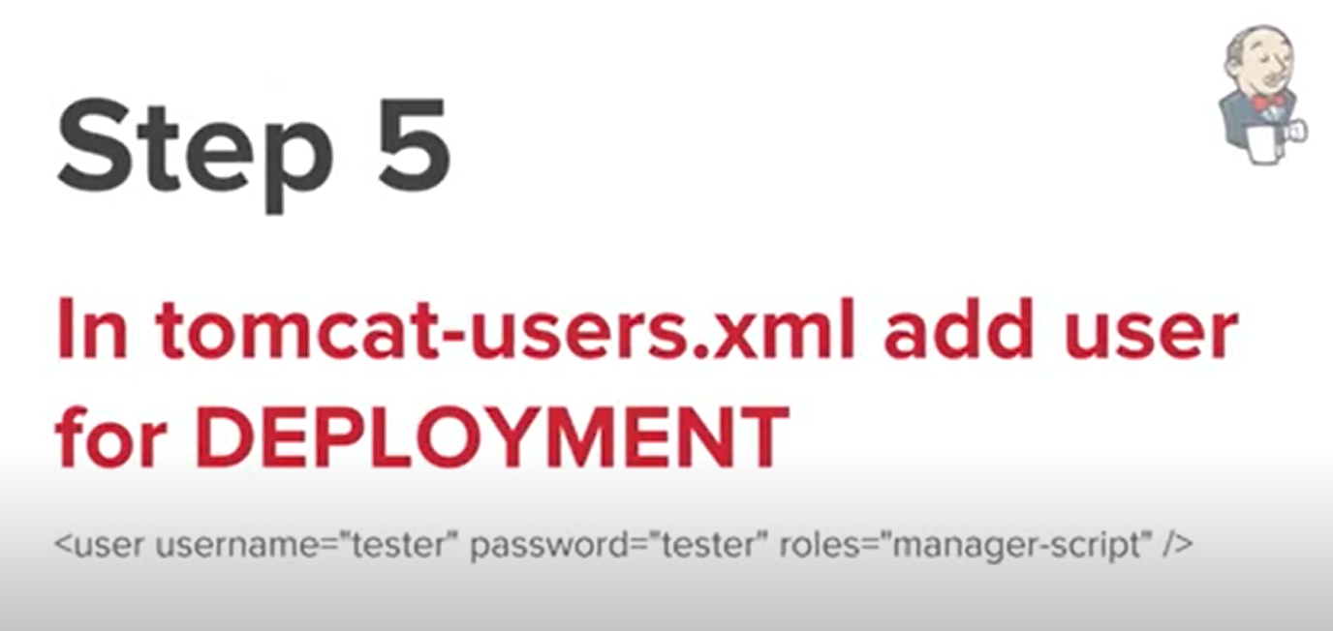

Slide 15
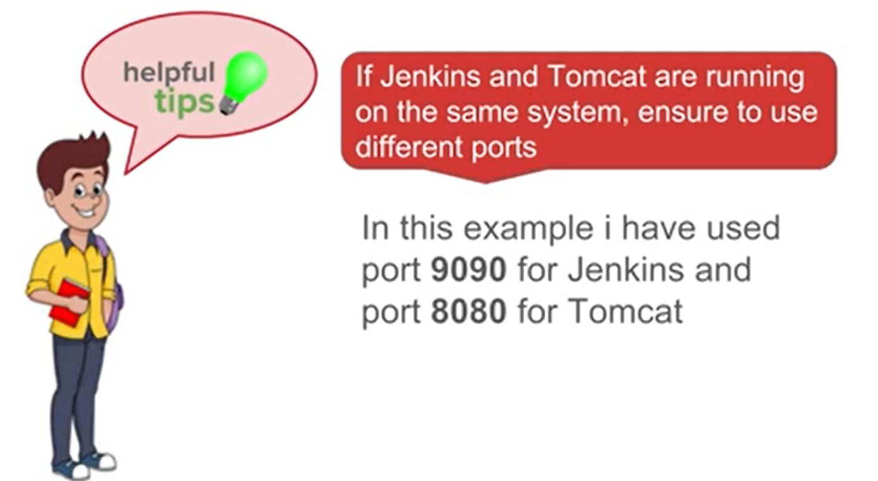

Slide 16
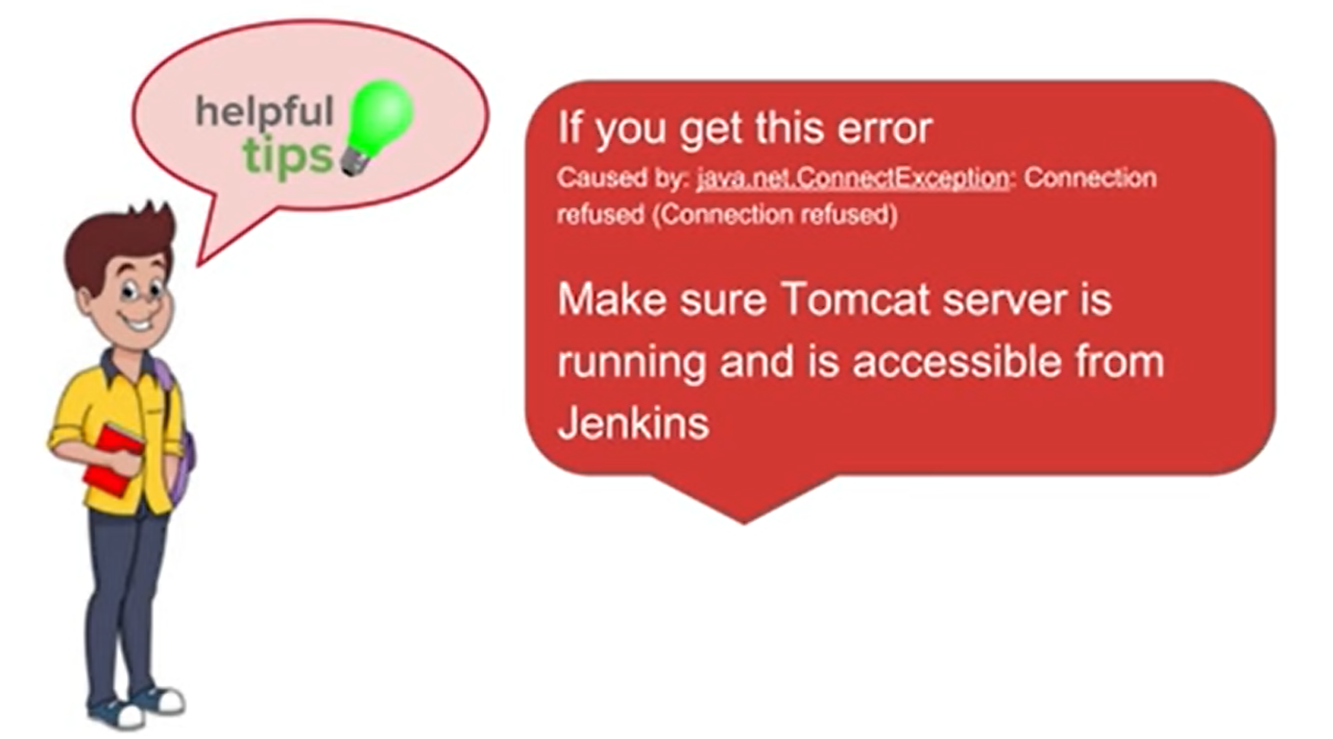

Slide 17


Slide 18
Jenkins Automated Deployment
Jenkins provides many plugins which can be used to transfer the build files to the respective application or web server after a successful build, for example, the "Deploy to container" plugin. This plugin takes a war or ear file and then it deploys to a running remote application server at the end of a build.

